Slide 1
MARCH 2021 LISTENING
Zoom Group Listening

Slide 2
Listening overview
Over 20 parent leaders were involved in leading the listening with parents
We held 9 listening groups on Zoom in English and Spanish
Over 120 parents were involved in sharing their views.
The questions we used in all groups were:
Share a word to describe PACT
What are the biggest challenges facing you as a parent
In the next year what should we (at PACT) we doing?
Would you be happy to help us?

Slide 3
1. Words to describe PACT

Slide 4
2. Biggest challenges facing parents

Slide 5
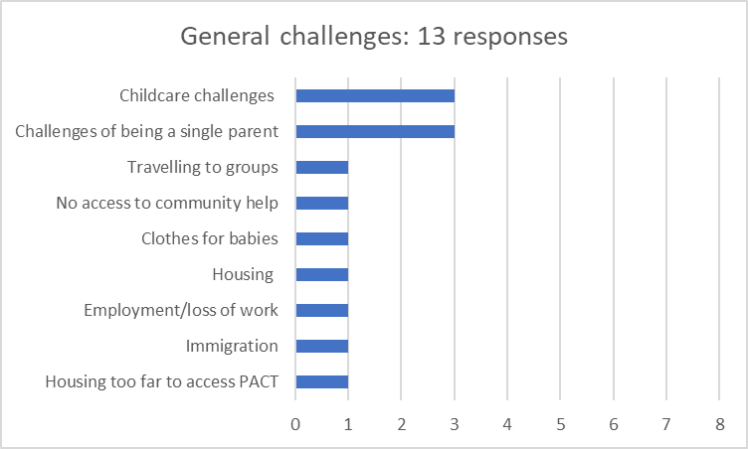
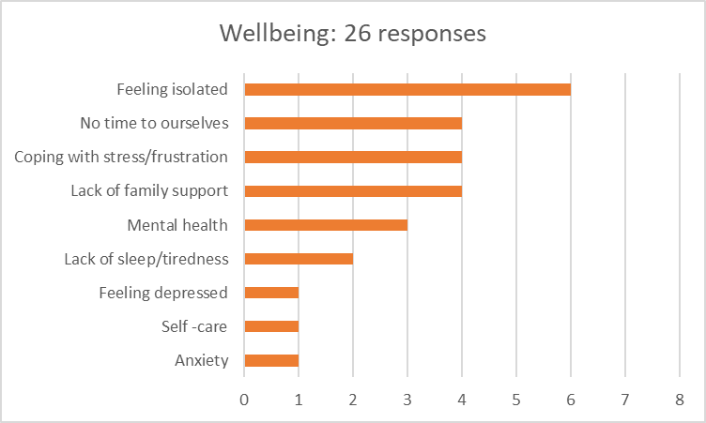
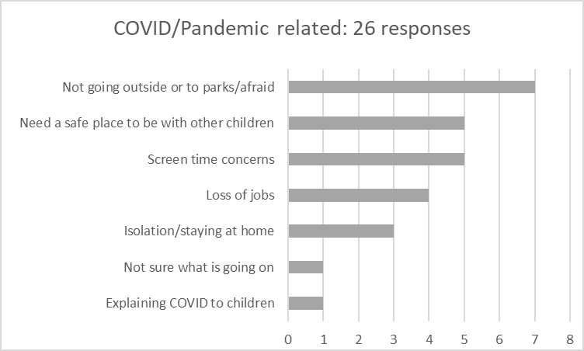
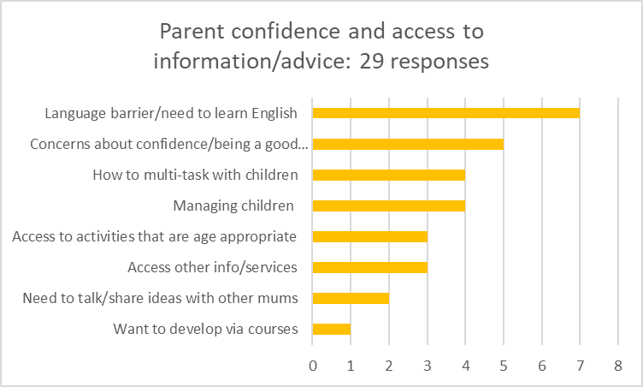
Biggest challenges facing parents

Slide 6
3. What can PACT do?

Slide 7
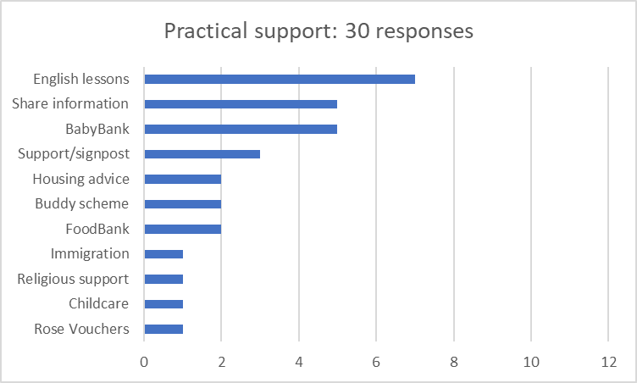
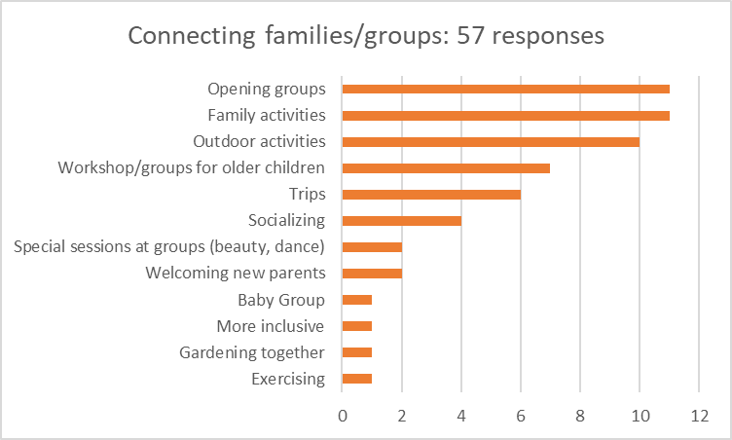
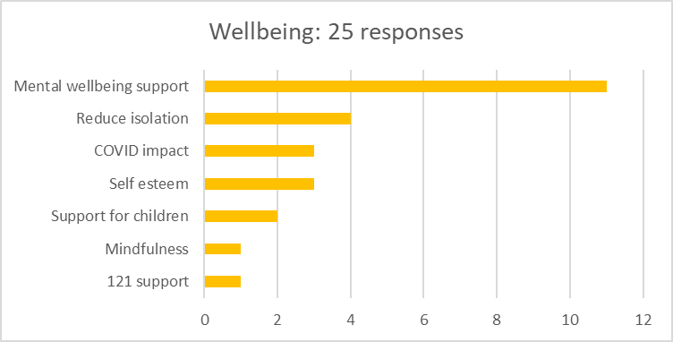
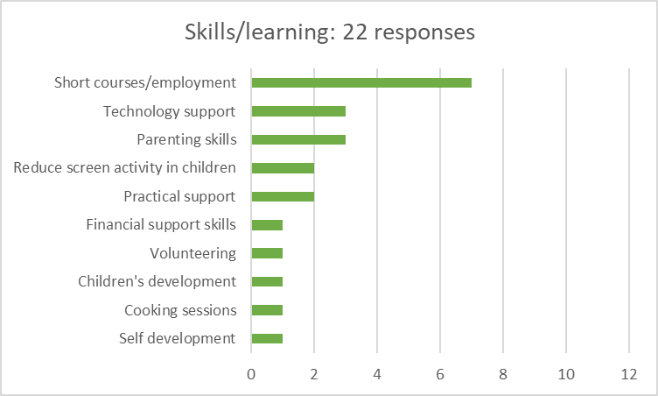
What can PACT do…..
Plus 3 responses around topic of leadership (promote groups, help other mums and develop leadership skills)

Slide 8
A place where everyone supports each other – a home away from home
An oasis for child to play and mums to keep in touch with others
Great support to interact and learn while having fun and sharing
I don’t have family in this country but made friends within PACT
Language barrier can be a problem to interact with other parents
I am foreigner in London and it can be lonely and isolating – lack of tribe
Fear of communicating due to lack of self-confidence in English
I want to do well in this country I do not belong to
A community of like-minded parents where I can contribute
More outdoor meetings – parks – more space. More trips and events outdoors
Small groups can meet outside
The garden is a space for family sharing and learning
Want classes on emotional wellbeing as after COVID will need it
Want socialising groups as we are too dependant on electronics
Want to meet with other mums and babies
Activities that will engage parents and children at same time
Parents want practical workshops to learn and also fun ones to relax and connect
Buddy scheme to have a have chat – one to one is good for people that are shy, Can have face to face talk to share about personal stuff.
Concerns about children being too dependant on electronics – how can parents help?
Parents found it hard to answer questions in the listening – need to do more of it!
Face to face groups are important – human connection

