Slide 1
PACT Parent Listening March/April 2021
Survey Results

Slide 2
Survey Overview
An online survey was shared with PACT families and volunteers in Spanish and English. We shared a link to the survey via WhatsApp, wea also provided an opportunity to fill in the survey on tablets at a Rose Voucher distribution session.
We received a total of 117 responses (57 English, 60 Spanish).
Some respondents did not answer all of the questions.

Slide 3
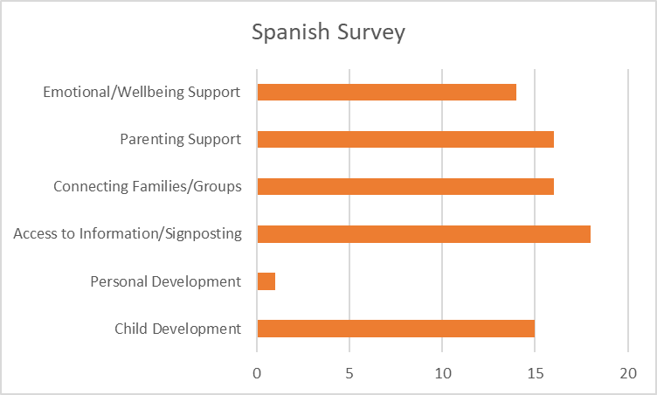
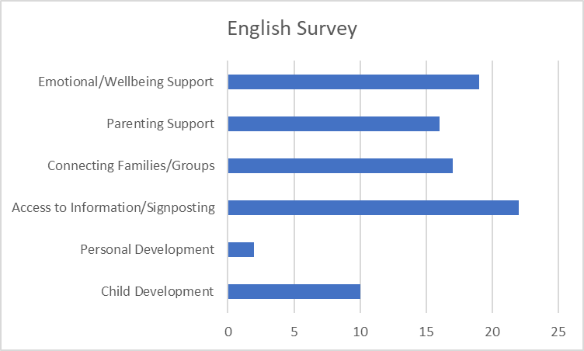
What support does a new parent / parent of a young child most need?
This was an open question. Answers were categorized (see next slide for more information on categories)
Results represent the frequency that a category is mentioned.

Slide 4
What support does a new parent / parent of a young child most need?
Child Development:
“Information on things that will help a child grow and develop to their full potential (activities etc.)“
Play
Socialising
Physical and emotional development
Education/School readiness
Personal Development:
“A place to explore themselves and develop outside the shell of being a mother.”
Access to information and signposting:
Housing
Financial/economic support
Health Visitor
Food & Foodbank
Government support available/Benefits
Baby bank
Rose Vouchers
Practical items, clothes, toys, nappies etc.
ESOL (particularly the Spanish speaking mums)

Slide 5
What support does a new parent / parent of a young child most need?
Connecting Families/Groups:
Group activities
Sharing experiences
Active groups
Reducing isolation
Provide encouragement
Creating a community
Making friends
Parenting Support:
Learn tips on parenting
“Help to know how to take care of our children.”
“advice about colics, teething and other problems “
Breast feeding
Emotional/ Wellbeing support:
Mental health, psychological support
Children and parent’s wellbeing
Emotional and physical
Community and Friendship
“feeling cared for”
“feeling cared for, belonging to the community. Safe place based on inclusion and equality”

Slide 6
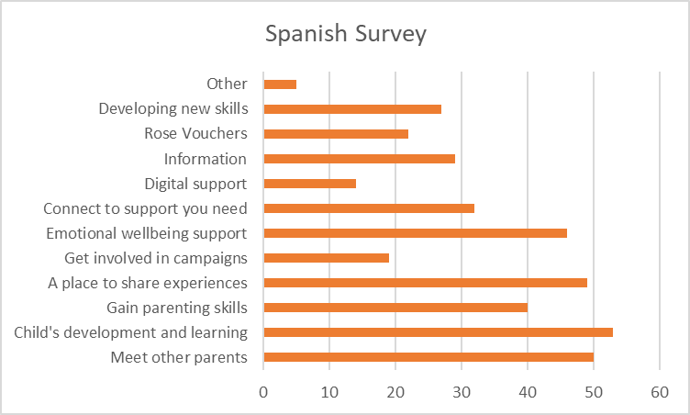
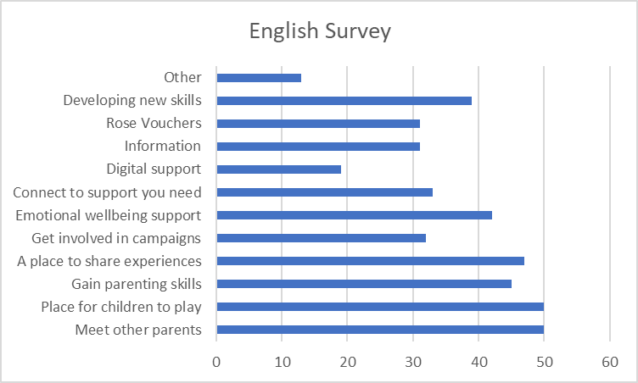
Why do you come to PACT?
Note: many parents selected more than 3 options
Results are the frequency something is mentioned...

Slide 7
Why do you come to PACT? Responses under ‘other’
Create community
Trying to find a job
How to build confidence
Place for children to play, gain parenting skills, Emotional wellbeing support
PACT to me is home where I can always be myself and meet like minded people.
With supportive volunteers and Every ready staff who will point you towards the right direction to get the right support and they will do everything possible to ensure you achieve the goal.
PACT is a community that raise future leaders by supporting parents physically, mentally psychologically and emotionally
Educating myself
Support about housing or immigration lawyers or look a solution what we can do?
Improve my English
I like to be around different backgrounds
I came to meet parents from my Spanish speaking community and for volunteering

Slide 8
Why do you come to PACT? Responses under ‘other’
Create community
Trying to find a job
How to build confidence
Place for children to play, gain parenting skills, Emotional wellbeing support
PACT to me is home where I can always be myself and meet like minded people.
With supportive volunteers and Every ready staff who will point you towards the right direction to get the right support and they will do everything possible to ensure you achieve the goal.
PACT is a community that raise future leaders by supporting parents physically, mentally psychologically and emotionally
Educating myself
Support about housing or immigration lawyers or look a solution what we can do?
Improve my English
I like to be around different backgrounds
I came to meet parents from my Spanish speaking community and for volunteering

Slide 9
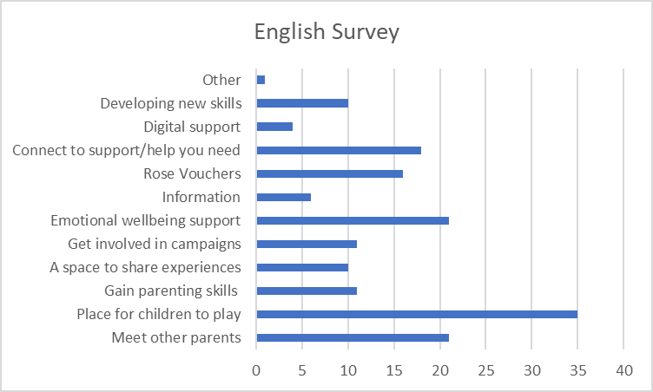
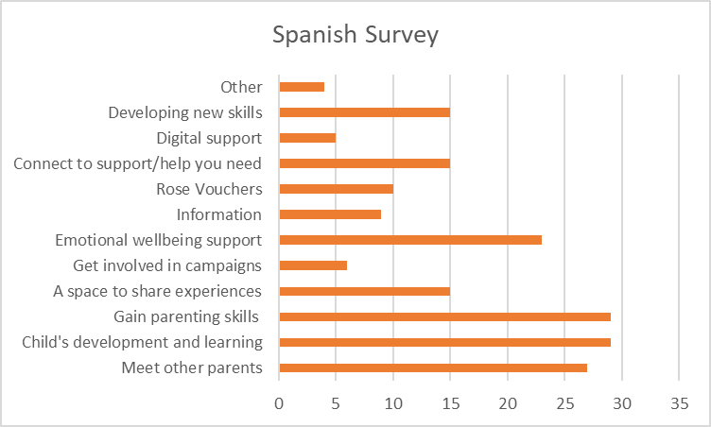
If PACT could only continue with 3 of your choices, what would they be?
Results represent the frequency that a category is mentioned.

Slide 10
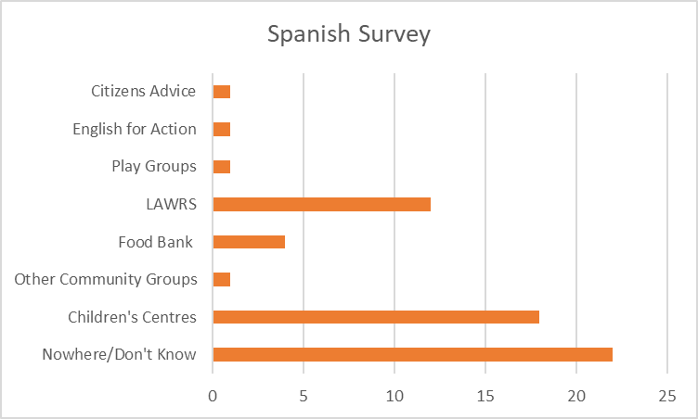
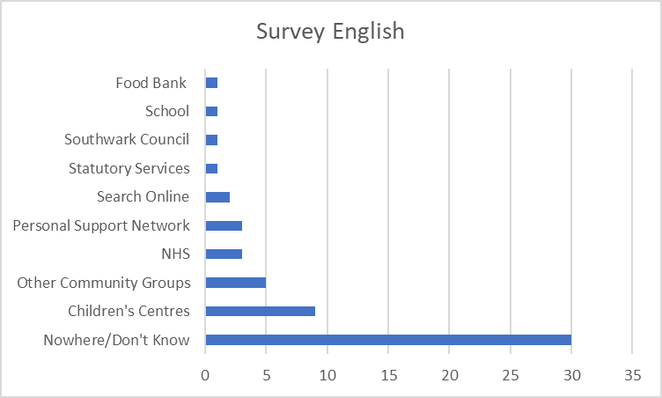
If PACT did not exist, where else might you go for support?
This was an open question and answers were categorized.
Results represent the frequency that a category is mentioned.

Slide 11
If PACT did not exist, where else might you go for support? Notes on categories
Children’s Centres: Often 1st Place Children’s Centre was named specifically (only in the Spanish survey)
NHS: Health Visitor (most frequent), GP
LAWRS: Latin American Women’s Rights Service
Other Community Groups: Mummies Republic was specifically mentioned by one mum
Personal Support Network: Included friends and family

Slide 12
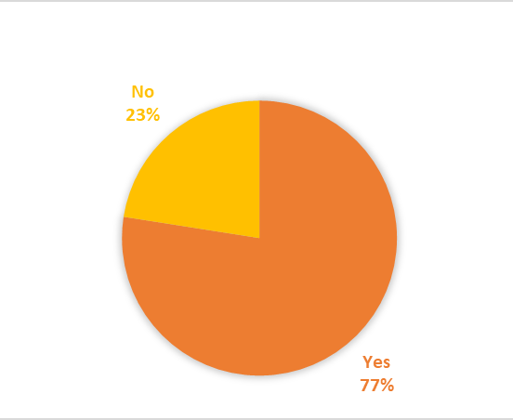
Have you noticed our focus on parent leadership?

Slide 13
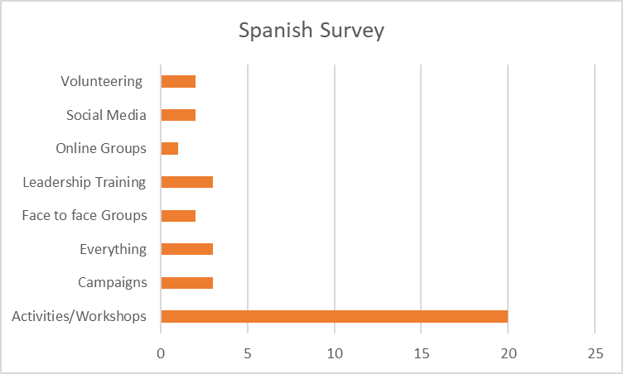
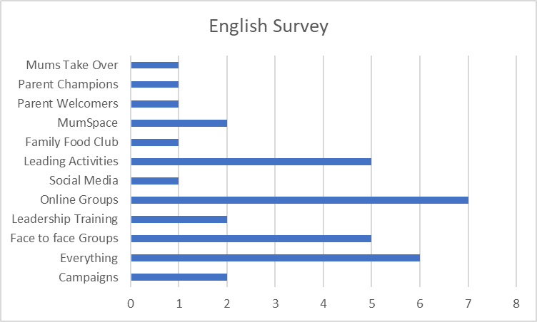
If YES, where and when?
This was an open question and answers were categorized.
Results represent the frequency that a category is mentioned.

Slide 14
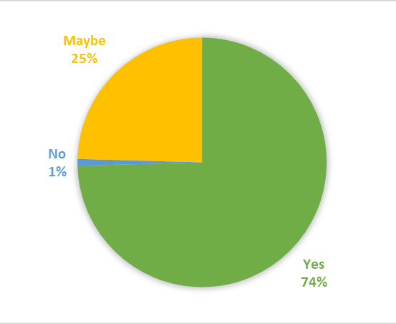
Would you like to get involved with PACT to help us grow and develop?

Slide 15
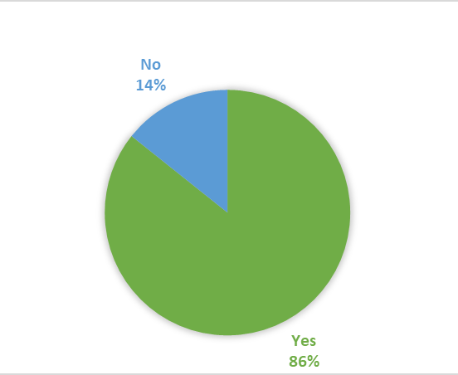
Would you be happy to have a follow up call to explore your ideas and thoughts?

